Slide 1
15IT303J
15IT303J | COMPUTER NETWORKS
COMPUTER
NETWORKS

Slide 2
UNIT I : INTRODUCTION TO COMPUTER NETWORKS
Evolution of Computer Networks
Classification of Computer Networks LAN,WAN,MAN
Network Topology : BUS, STAR, RING, MESH -
OSI Layered Architecture
TCP/IP Model

Slide 3
Outline
Data Communication Overview
Definition
Components
Protocols and standards
Network Overview
Connectivity
Categories
Internetworks

Slide 4

Motivations
Efficient way to share resources
Cost – less expensive
Accessibility – easier
Efficient way to exchange information
Time – faster
Size – bigger
Correctness – more accurate

Slide 5
Data Communication: Definition
Data Communication:
Transfer of data from one device to another via
some form of transmission medium.

Slide 6

Data Communication
Hi,
Hi,
how
how
are
are
you?
you?
Hi, how are you?
Hi, how are you?
Computer
01010001
01010001

Slide 7
Components in Communication
1
Message
Hi, how are you?
5
Protocol
2
Sender
3
Receiver
4
Medium

Slide 8


Data Representation
Numbers
8/16/32 bit integers
floating point
Text
ASCII, Unicode
Images
Bit patterns, Graphics formats JPG/GIF/etc
Audio → Samples of continuous signal
Video → Sequence of bitmap images
150
2
255

Slide 9
Protocols and Standards
Protocol
A set of rules governing data communications
Syntax: format of data block
Semantics: meaning of each section
Timing: speed and sequencing
Standards
De facto (in practice) standards
→ not approved but widely adopted
De jure (in law) standards
→ approved by an organization

Slide 10
Standards Organizations
Creation Committees
ISO, ITU-T, ANSI, IEEE, EIA
Forums
Regulatory Agencies

Slide 11
Direction of Data Flow
Simplex: One direction only
data flow
Server
Monitor
data flow
Keyboard

Slide 12
Direction of Data Flow
Half Duplex: Both directions, one at a time
E.g., walkie-talkies
data flow at time 1
data flow at time 2

Slide 13

Direction of Data Flow
Full Duplex: Both directions simultaneously
E.g., telephone
Can be emulated on a single communication link using various methods
data flow
data flow

Slide 14
Networks
Network: a set of devices connected by media links
Laptop
Workstation
Media Links
Server
Printer
Scanner

Slide 15
Types of Connections
Point-to-point
Multipoint (multidrop)

Slide 16


Point-To-Point Connection

Slide 17
Multipoint Connection
Wireless

Slide 18
Topology
Topology: physical or logical arrangement of devices
Point-to-point
Mesh
Star
Bus
Ring
Hybrid

Slide 19
Point-to-Point Connection

Slide 20
Fully Connected Mesh Topology
E
A
D
B
C

Slide 21
Fully Connected Mesh Topology

Slide 22
Fully Connected Mesh Topology
Pros:
Dedicated links
Robustness
Privacy
Easy to identify fault
Cons:
A lot of cabling
I/O ports
Difficult to move

Slide 23
Star Topology
A
D
Hub
Drop
B
C
Drop

Slide 24
Star Topology
A
D
Switch
B
C

Slide 25
Star Topology
A
D
Hub
B
C

Slide 26
Star Topology
Pros:
One I/O port per device
Little cabling
Easy to install
Robustness
Easy to identify fault
Cons:
Single point of failure
More cabling still required
Hub

Slide 27
Bus Topology
Drop line
Tap
Terminator

Slide 28
Bus Topology
A
B
C
D

Slide 29
Bus Topology

Slide 30
Bus Topology
Pros:
Little cabling
Easy to install
Cons:
Difficult to modify
Difficult to isolate fault
Break in the bus cable stops all transmission

Slide 31
Ring Topology
C
D
B
A

Slide 32
Ring Topology

Slide 33
Ring Topology
Pros:
Easy to install
Easy to identify fault
Cons:
Delay in large ring
Break in the ring stops all transmission

Slide 34
Hybrid Topologies

Slide 35
Network Categories
Local Area Network (LAN)
Wide Area Network (WAN)
Metropolitan Area Network (MAN)

Slide 36
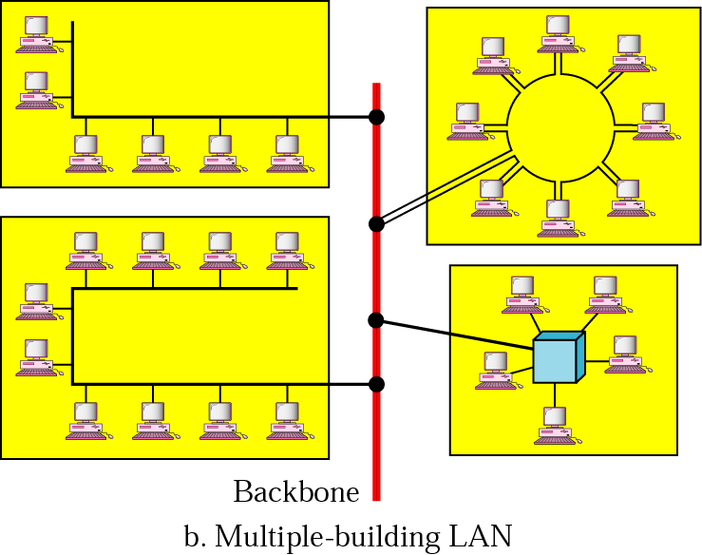
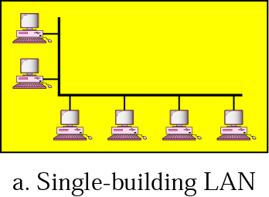
Local Area Networks
Network in a single office, building, or campus

Slide 37
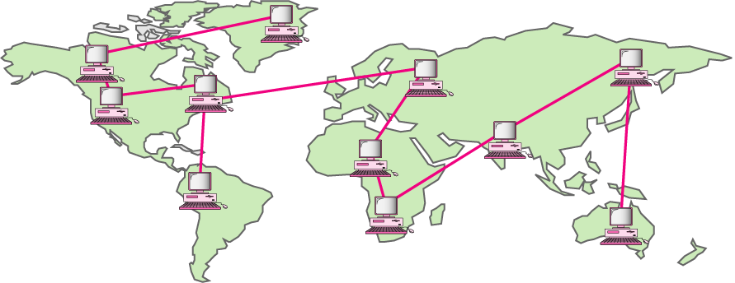
Wide Area Networks
Network providing long-distance communication over a country, a continent, or the whole world

Slide 38
WAN Technologies
Circuit Switching
Physical links are dedicated between two points
Packet Switching
Data are put in packets which are stored and forwarded at each node
Virtual Circuit Switching
Virtual links are established between two points
→ Frame Relay and ATM (Asynchronous Transfer Mode)

Slide 39

Metropolitan Area Networks
Network extended over an entire city
Bangkhen
Kampangsaen

Slide 40



Switching
Dedicated circuits
Circuit switching
Telephone switches establish circuits for communication
Packet switching
Data are put into packets
Each stamped with source and destination addresses
Routers know where to forward packets
telephone switch
Packet
Router

Slide 41
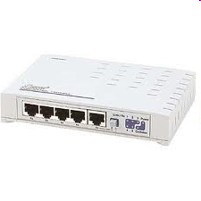
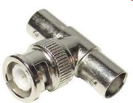
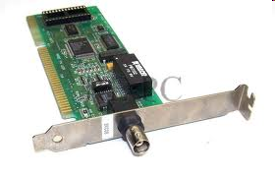
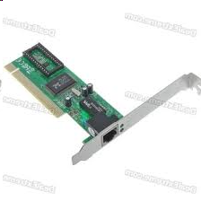
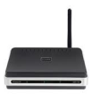
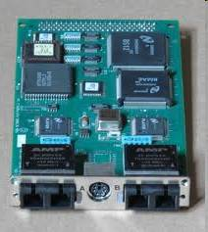
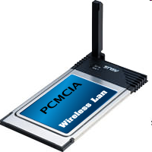
Network of Networks
Company A
Company B
Network Interface Card (NIC)
Company C
Company D

Slide 42

Internetworking
How to allow devices from different standards to communicate
Gateways/routers – devices capable of communicating in several standards
These become "network of networks"

Slide 43
Internetworks
Two or more networks connected become an internetwork, or internet
Example: The Internet
Network1
Network2
Gateway
Network3

Slide 44
The Internet
The largest internetwork (network of networks) in the world
Devices communicating with TCP/IP protocol suite
Stanford
U. of Utah
UC Santa Barbara
UCLA

Slide 45
Summary
Data communication
Protocols and standards
Computer networks
Topologies
LAN/MAN/WAN
Internetworks (networks of networks)

Slide 46
2-1 LAYERED TASKS
We use the concept of layers in our daily life. As an example, let us consider two friends who communicate through postal mail. The process of sending a letter to a friend would be complex if there were no services available from the post office.
Topics discussed in this section:
Sender, Receiver, and Carrier Hierarchy

Slide 47
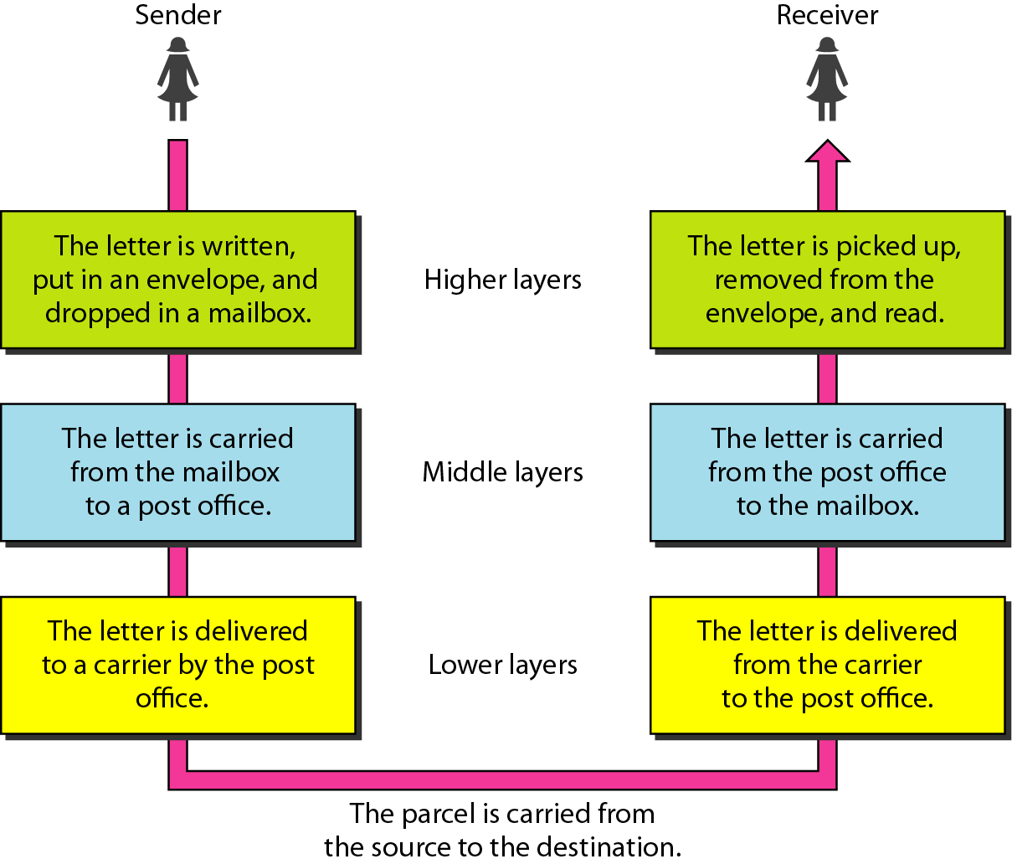
Figure 2.1 Tasks involved in sending a letter

Slide 48
2-2 THE OSI MODEL
Established in 1947, the International Standards Organization (ISO) is a multinational body dedicated to worldwide agreement on international standards. An ISO standard that covers all aspects of network communications is the Open Systems Interconnection (OSI) model. It was first introduced in the late 1970s.
Topics discussed in this section:
Layered Architecture Peer-to-Peer Processes
Encapsulation

Slide 49

Note
ISO is the organization. OSI is the model.

Slide 50
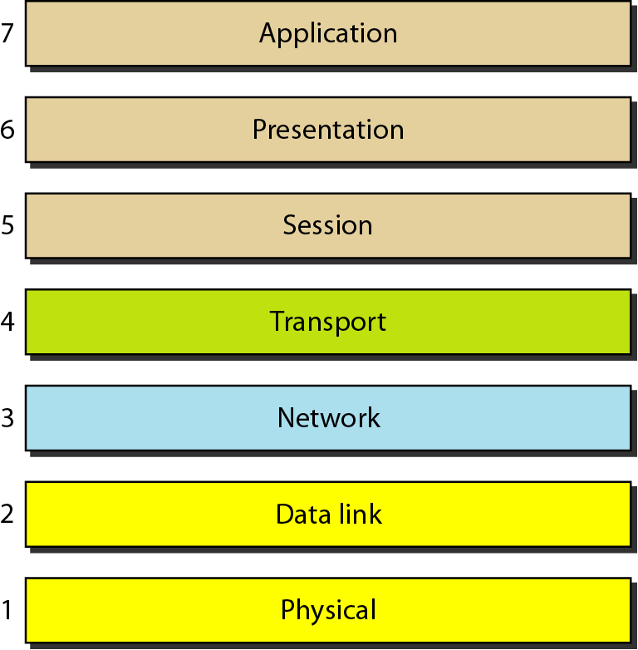
Figure 2.2 Seven layers of the OSI model

Slide 51
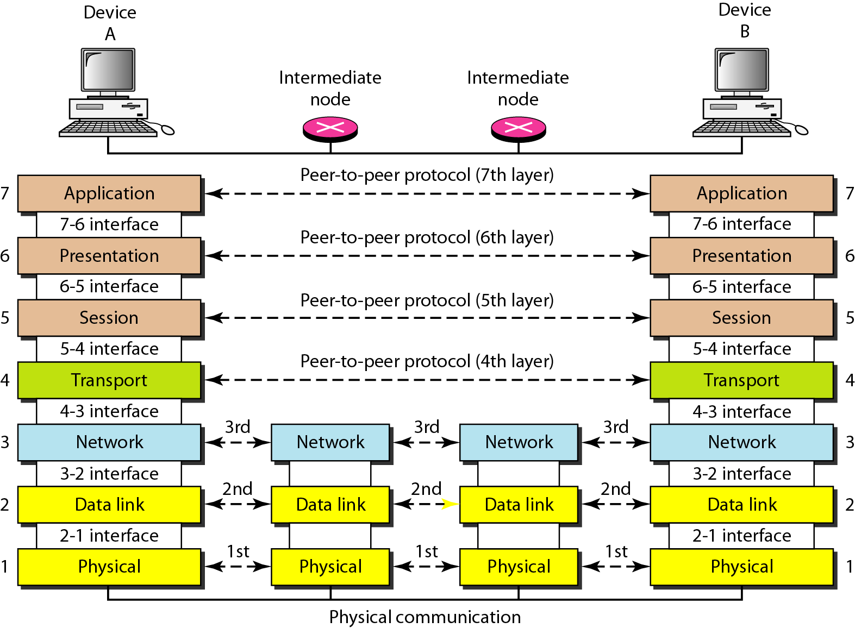
Figure 2.3 The interaction between layers in the OSI model

Slide 52
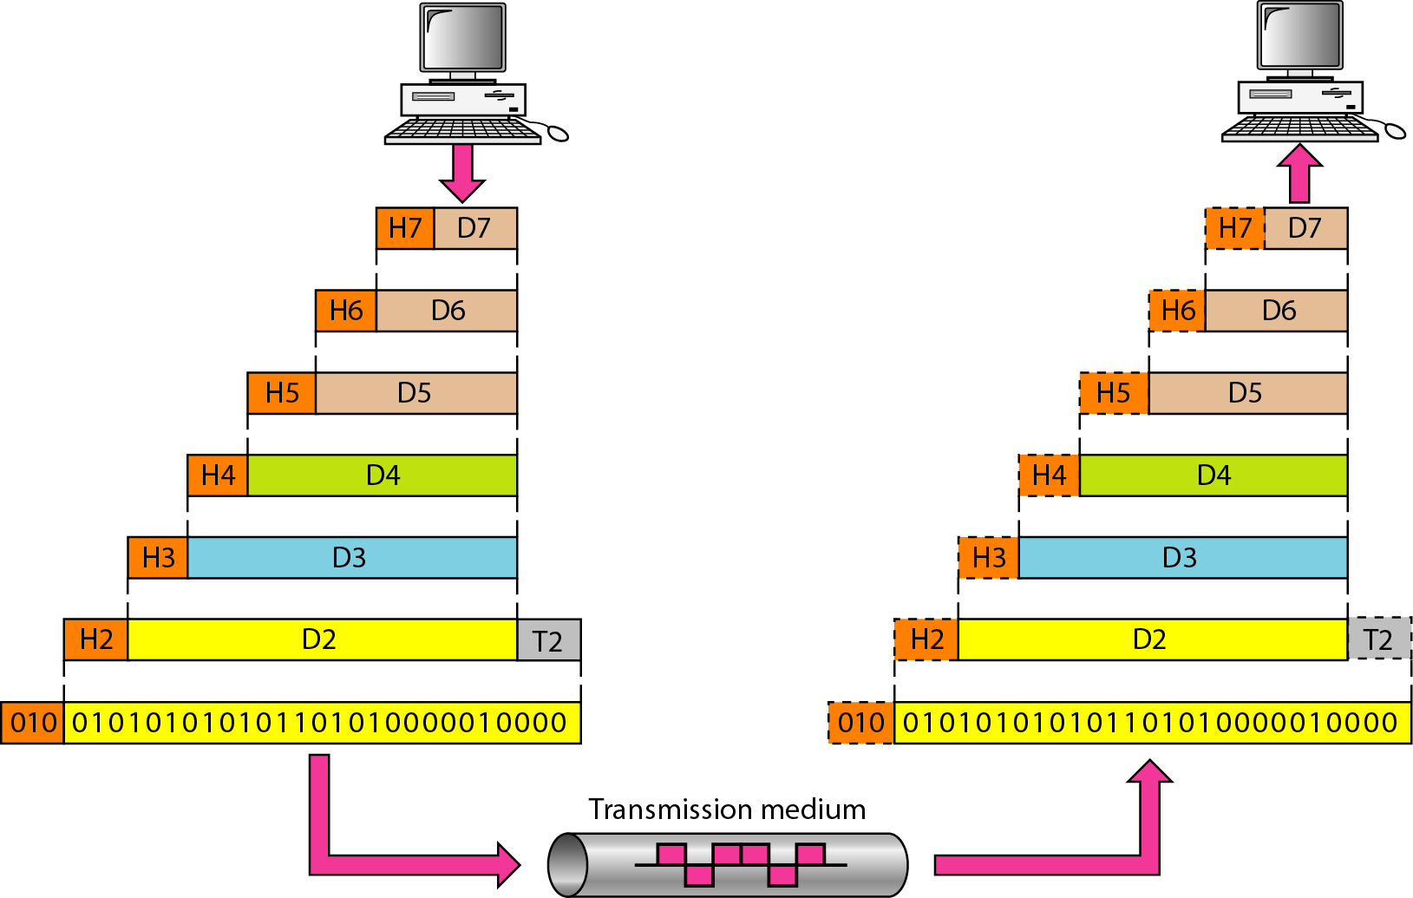
Figure 2.4 An exchange using the OSI model

Slide 53
2-3 LAYERS IN THE OSI MODEL
In this section we briefly describe the functions of each layer in the OSI model.
Topics discussed in this section:
Physical Layer Data Link Layer
Network Layer
Transport Layer
Session Layer
Presentation Layer
Application Layer

Slide 54
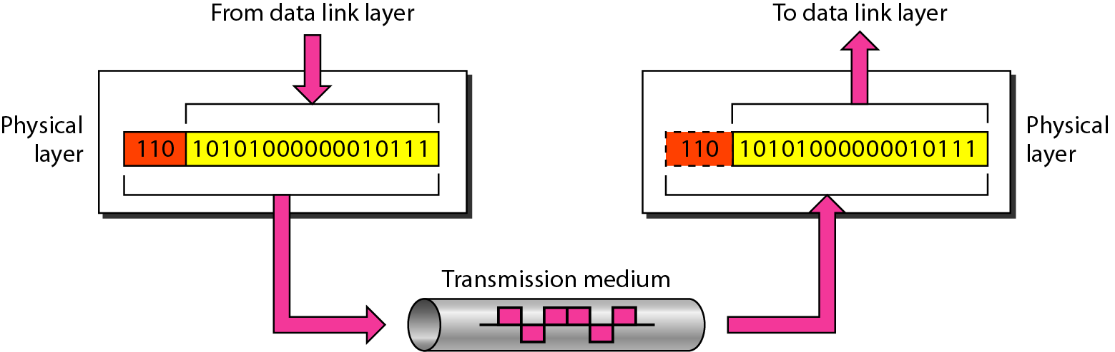
Figure 2.5 Physical layer

Slide 55
Note
The physical layer is responsible for movements of
individual bits from one hop (node) to the next.

Slide 56
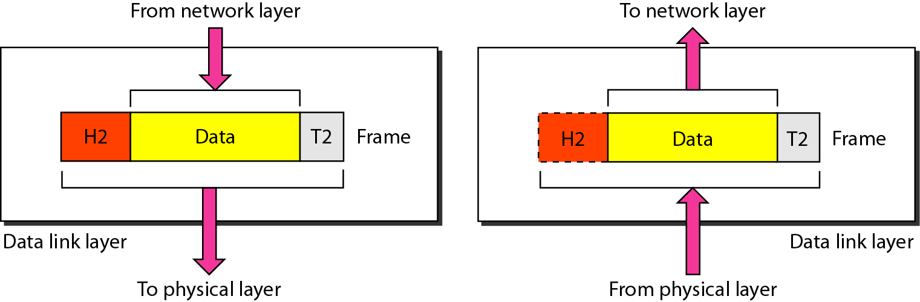
Figure 2.6 Data link layer

Slide 57
Note
The data link layer is responsible for moving frames from one hop (node) to the next.

Slide 58
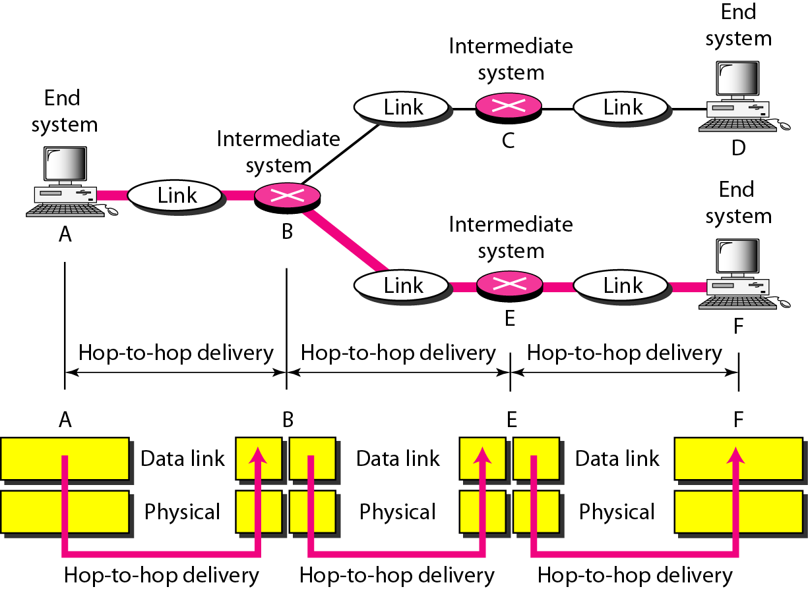
Figure 2.7 Hop-to-hop delivery

Slide 59
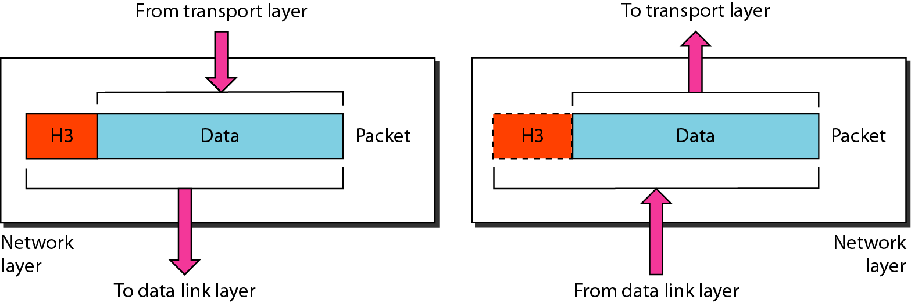
Figure 2.8 Network layer

Slide 60
Note
The network layer is responsible for the delivery of individual packets from
the source host to the destination host.

Slide 61
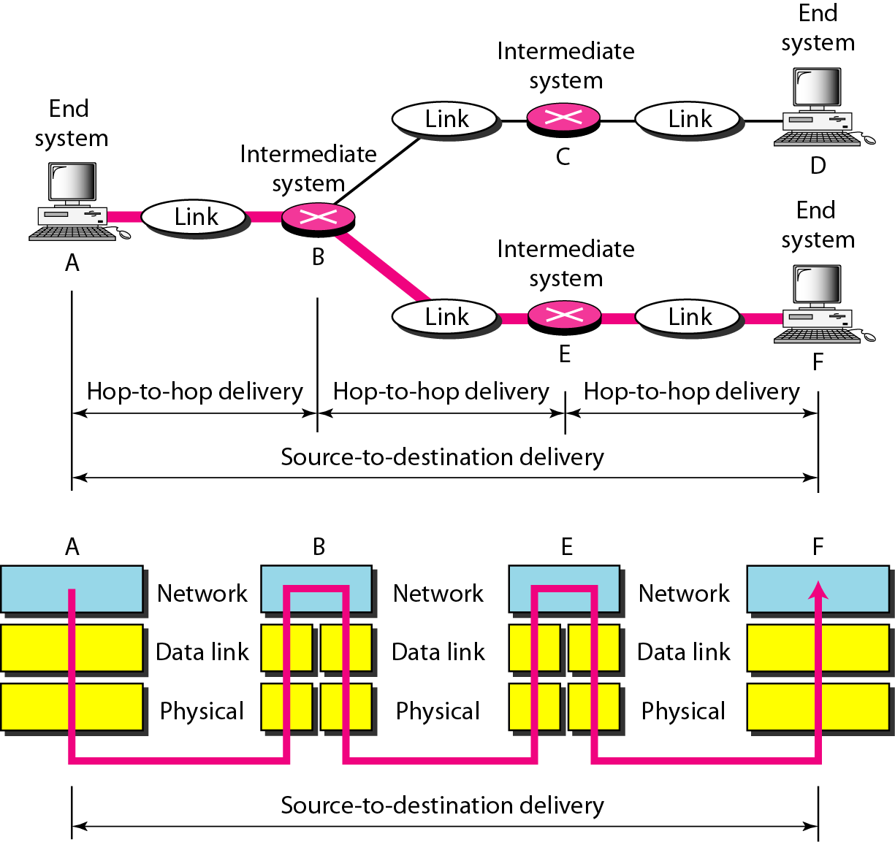
Figure 2.9 Source-to-destination delivery

Slide 62
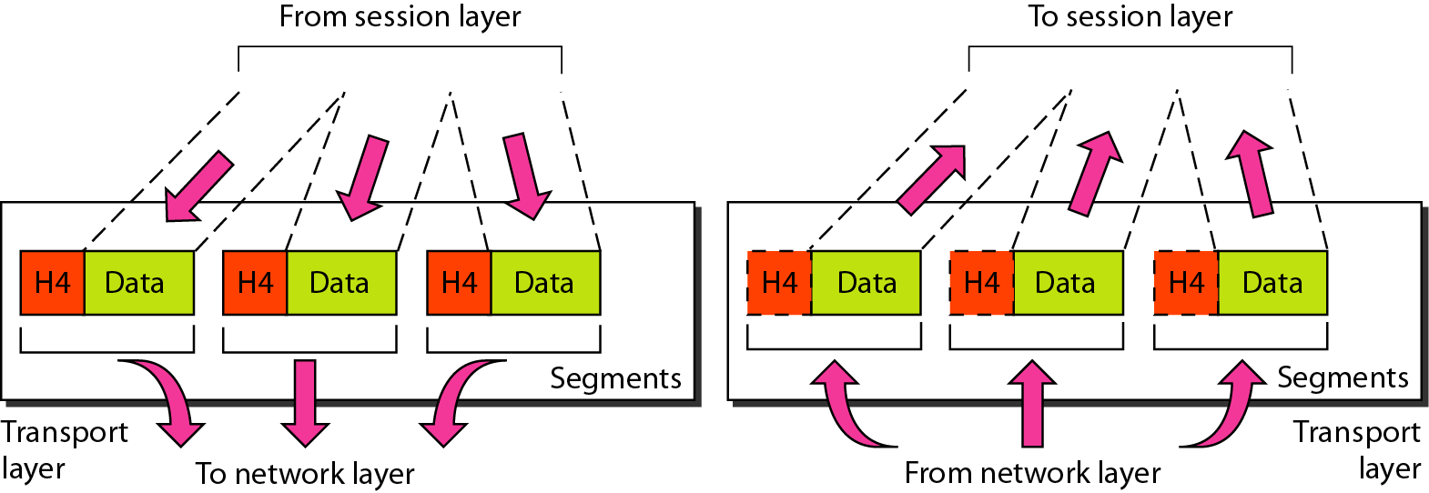
Figure 2.10 Transport layer

Slide 63
Note
The transport layer is responsible for the delivery of a message from one process to another.

Slide 64
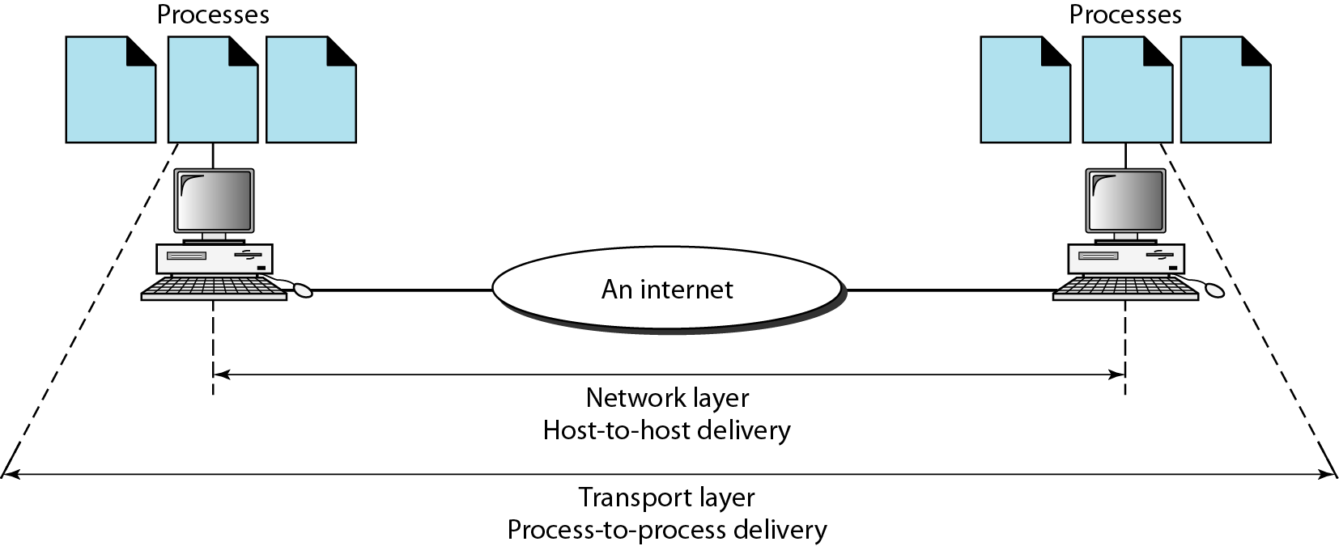
Figure 2.11 Reliable process-to-process delivery of a message

Slide 65
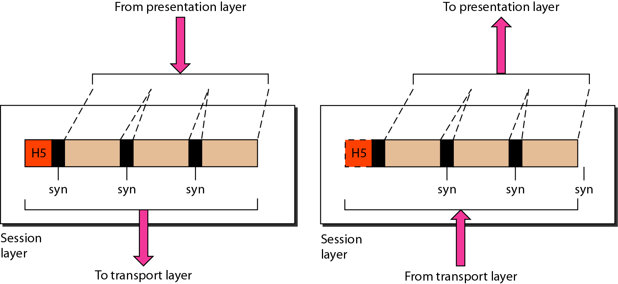
Figure 2.12 Session layer

Slide 66
Note
The session layer is responsible for dialog control and synchronization.

Slide 67
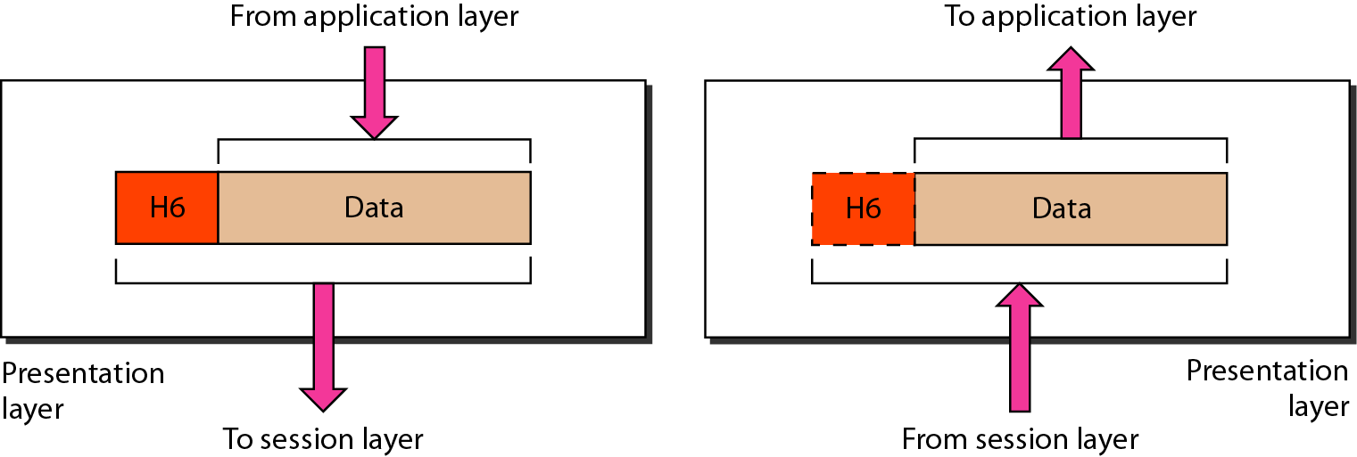
Figure 2.13 Presentation layer

Slide 68
Note
The presentation layer is responsible for translation, compression, and encryption.

Slide 69
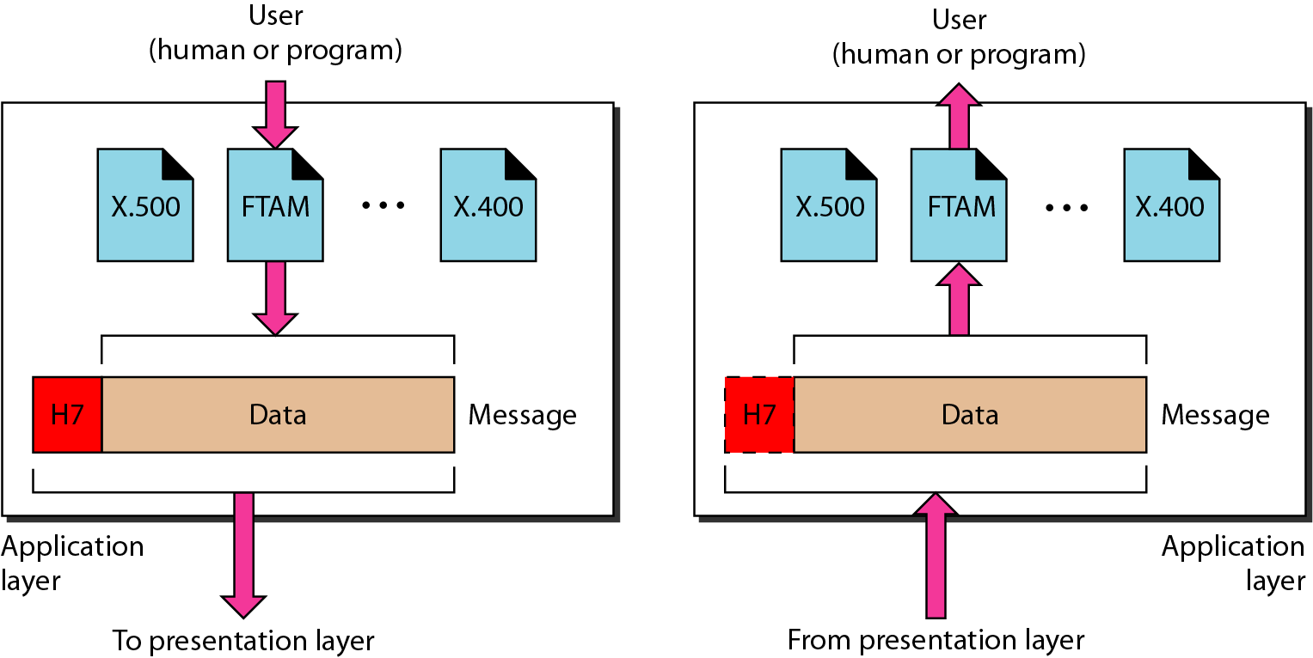
Figure 2.14 Application layer

Slide 70
Note
The application layer is responsible for providing services to the user.

Slide 71
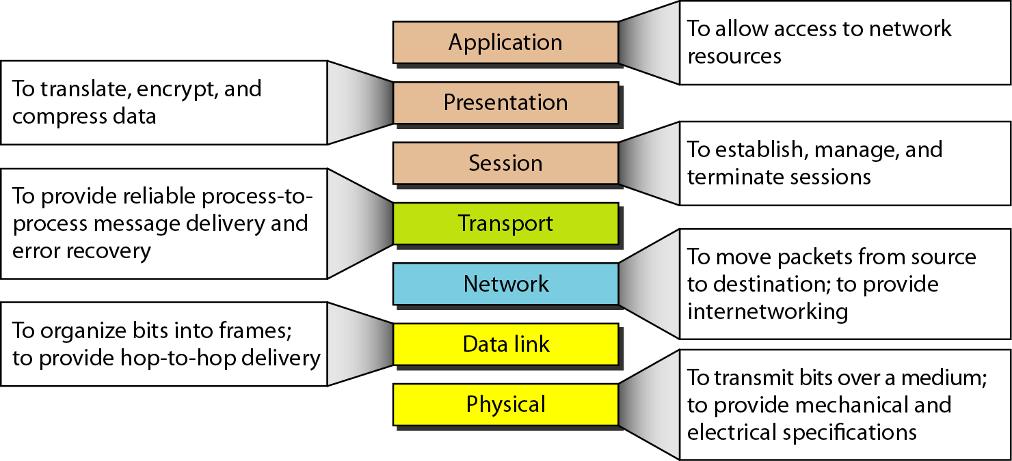
Figure 2.15 Summary of layers

Slide 72
2-4 TCP/IP PROTOCOL SUITE
The layers in the TCP/IP protocol suite do not exactly match those in the OSI model. The original TCP/IP protocol suite was defined as having four layers: host-to-network, internet, transport, and application. However, when TCP/IP is compared to OSI, we can say that the TCP/IP protocol suite is made of five layers: physical, data link, network, transport, and application.
Topics discussed in this section:
Physical and Data Link Layers Network Layer Transport Layer
Application Layer

Slide 73
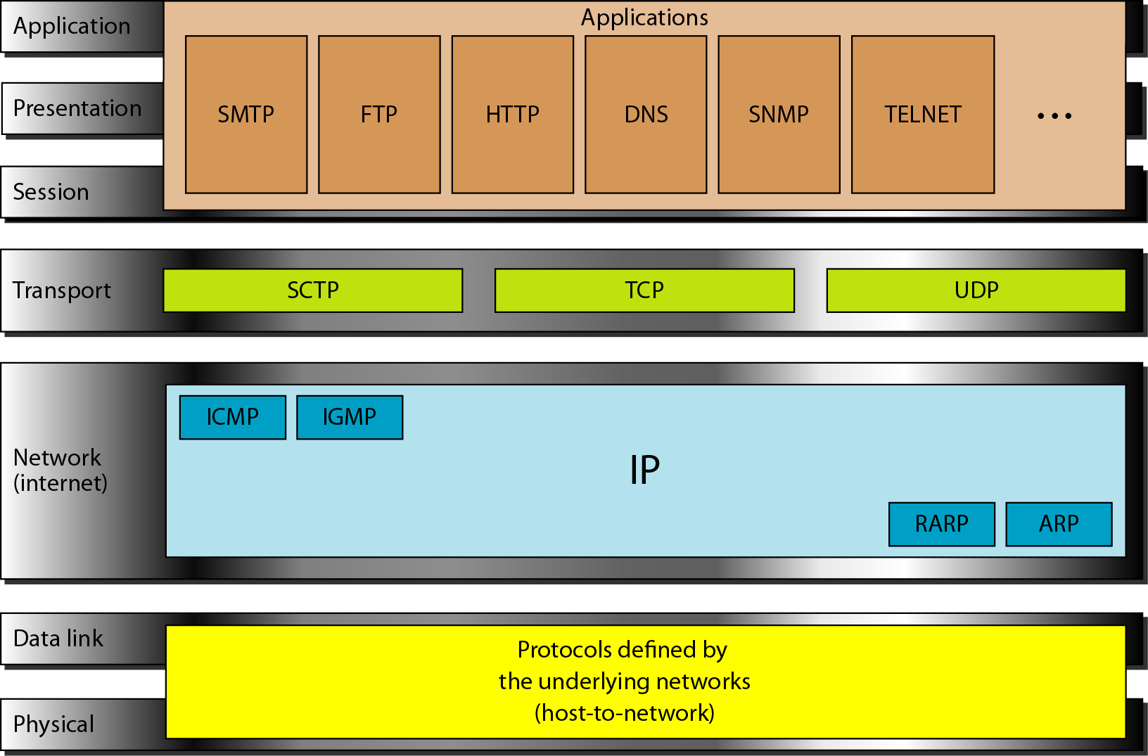
Figure 2.16 TCP/IP and OSI model

Slide 74
2-5 ADDRESSING
Four levels of addresses are used in an internet employing the TCP/IP protocols: physical, logical, port, and specific.
Topics discussed in this section:
Physical Addresses Logical Addresses Port Addresses Specific Addresses

Slide 75
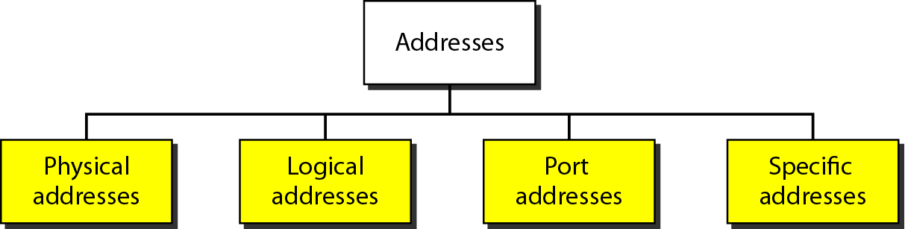
Figure 2.17 Addresses in TCP/IP

Slide 76
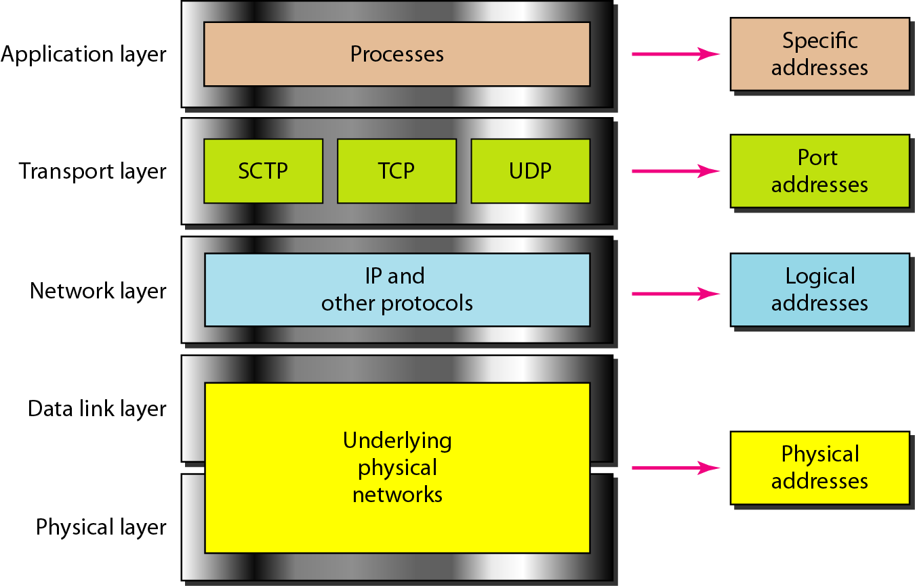
Figure 2.18 Relationship of layers and addresses in TCP/IP

Slide 77
Example 2.1
In Figure 2.19 a node with physical address 10 sends a frame to a node with physical address 87. The two nodes are connected by a link (bus topology LAN). As the figure shows, the computer with physical address 10 is the sender, and the computer with physical address 87 is the receiver.

Slide 78
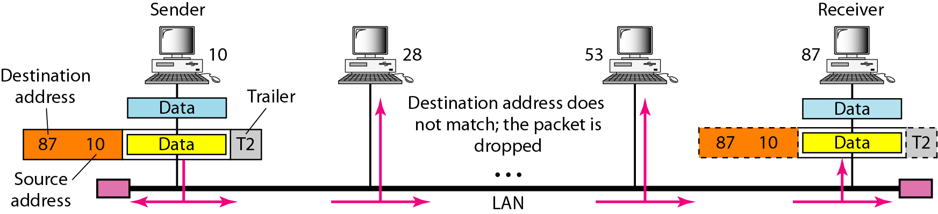
Figure 2.19 Physical addresses

Slide 79
Example 2.2
Most local-area networks use a 48-bit (6-byte) physical address written as 12 hexadecimal digits; every byte (2 hexadecimal digits) is separated by a colon, as shown below:
07:01:02:01:2C:4B
A 6-byte (12 hexadecimal digits) physical address.

Slide 80
Example 2.3
Figure 2.20 shows a part of an internet with two routers connecting three LANs. Each device (computer or router) has a pair of addresses (logical and physical) for each connection. In this case, each computer is connected to only one link and therefore has only one pair of addresses. Each router, however, is connected to three networks (only two are shown in the figure). So each router has three pairs of addresses, one for each connection.

Slide 81
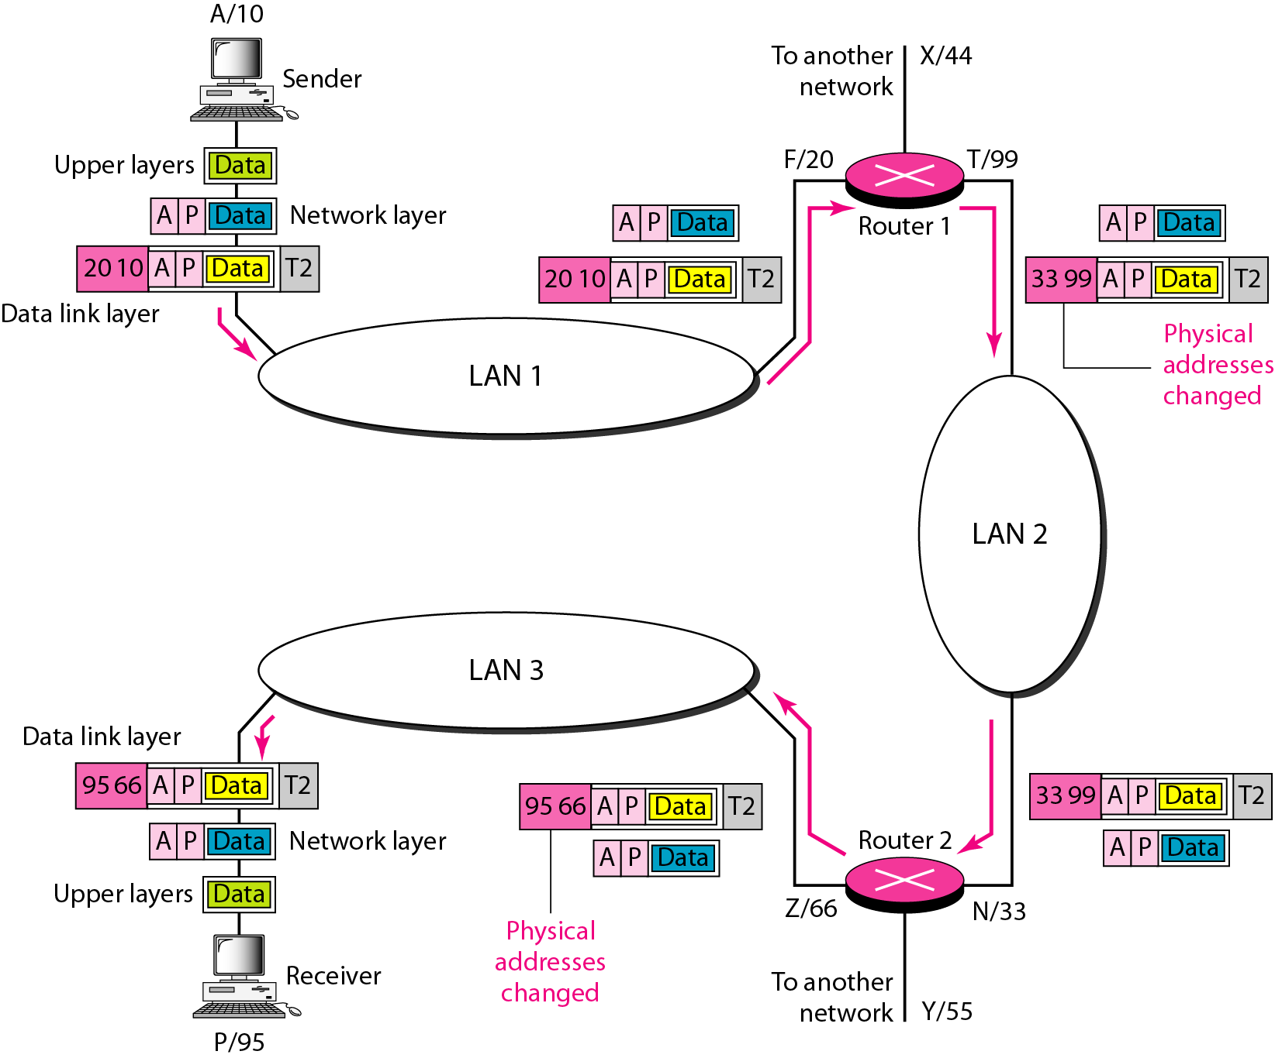
Figure 2.20 IP addresses

Slide 82
Example 2.4
Figure 2.21 shows two computers communicating via the Internet. The sending computer is running three processes at this time with port addresses a, b, and c. The receiving computer is running two processes at this time with port addresses j and k. Process a in the sending computer needs to communicate with process j in the receiving computer. Note that although physical addresses change from hop to hop, logical and port addresses remain the same from the source to destination.

Slide 83
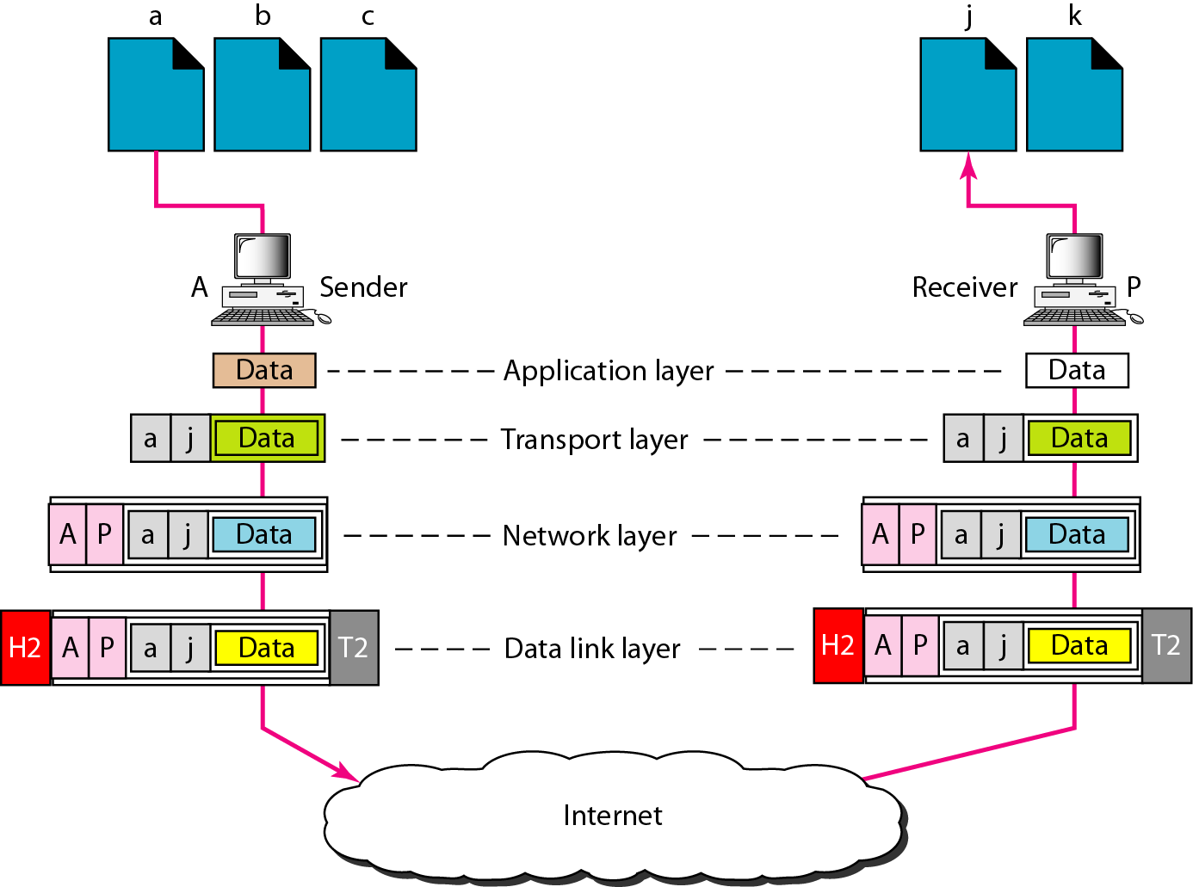
Figure 2.21 Port addresses

Slide 84
Note
The physical addresses will change from hop to hop,
but the logical addresses usually remain the same.

Slide 85
Example 2.5
A port address is a 16-bit address represented by one decimal number as shown.
753
A 16-bit port address represented as one single number.

Slide 86
Outline
Circuit vs. packet switching
Layered tasks
Internet protocol suites
ISO's OSI model

Slide 87
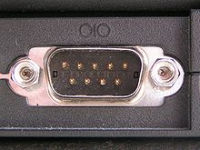
End-to-End Communication
Direct communication
Most basic form of communication
Internet communication
Communication is performed over the Internet
TX
TX
RX
RX
Serial Port
GND
GND
Internet

Slide 88
Internet Comm. - App's Viewpoint
Two network applications should interact as if they were directly connected
But what's going on underneath?
What is inside the "cloud"?
write
read
App
App
A
B
Internet

Slide 89
Circuit vs. Packet Switching
Early communication networks
Dedicated circuit
Electronic switches are used
Circuit switching
In 1960s, packet switching concept revolutionized data communications
Provides the basis for the modern Internet
Allows multiple users to share a network
Divides data into small blocks, called packets
Includes an identification of the intended recipient in each packet

Slide 90
Circuit vs. Packet Switching
Dedicated circuits
Circuit switching
Telephone switches establish circuits for communication
Packet switching
Data are put into packets
Each stamped with source and destination addresses
Routers know where to forward packets
telephone switch
Packet
Router

Slide 91
Layered Tasks
Computer networks are complex systems
Tasks involve varieties of hardware and software components, and protocols
Networking task is divided into several subtasks, or layers

Slide 92
Real World Example
Communication between managers of two companies
Communicate

Slide 93
What Actually Happens
Communication takes place thru many layers
Logical communication
Secretary: reads and reports the message
Secretary: types a letter
Delivery boy: drops the letter
Delivery boy: takes the letter
Postal truck
Post office:
Processes and routes the letter

Slide 94
Layer Model
Layer N uses services provided by Layer N-1
HOST A
HOST B
Logical communication path
Layer N
Layer N
Layer N protocol
Using services
Providing services
Layer N-1
Layer N-1
Layer N-2
Layer N-2
Virtual Communication System

Slide 95
Why Layers?
Guidelines for protocol developments
Reference model
Modularity
Eases maintenance and updating of systems
A change in one layer is transparent to the rest
Is layering always the best thing to do?
Maybe not ⇨ cross-layer optimization

Slide 96
Internet Layer Model
The Internet Protocol Stack
User
Application Layer
Transport Layer
Network Layer
Data Link Layer
Physical Layer
Software
Hardware
Transmission Medium

Slide 97


Application Layer
Responsible for providing services to the user
The only layer to interact with user
Data
Logical communication
Data
Application Layer
SMTP
HTTP
FTP
SMTP
HTTP
FTP
Data
H5
Data
H5
to Transport
from Transport

Slide 98
Transport Layer
Responsible for delivery of a message from one process to another
Duties/services
Port addressing
Segmentation and reassembly
Connection control
Flow control (end-to-end)
Error control (end-to-end)

Slide 99
Transport Layer
Process
Process
…
Process
Process
…
PORT #
PORT #
Data
Data
Transport Layer
Data₁
H4
Data₂
H4
Data₃
H4
Data₁
H4
Data₂
H4
Data₃
H4
(segments)
to Network
from Network

Slide 100
Network Layer
Responsible for the delivery of packets from the original source to the destination
Duties/services
Logical addressing
Routing

Slide 101
Network Layer
from Transport
to Transport
Data
Data
Network Layer
Data
H3
Data
H3
(packet)
to Data Link
from Data Link

Slide 102
Network Layer
Data
1.1
5.7
1.1, 1.2, 6.1, 5.7, ... are logical addresses
1.1
1.2
Network 1
R1
6.1
Network 6
6.6
6.3
R3
R2
5.2
Router
3.3
Network 5
5.7
Network 3
3.8

Slide 103
Data Link Layer
Responsible for transmitting frames from one node to the next
Duties/services
Framing
Physical addressing
Flow control (hop-to-hop)
Error control (hop-to-hop)
Access control

Slide 104
Data Link Layer
from Network
to Network
Data
Data
Data Link Layer
T2
Data
H2
T2
Data
H2
(frame)
to Physical
from Physical

Slide 105
Data Link Layer
A3, 3B, 82, 9F, ... are physical addresses
Data
9F
3B
82
A3
T2
Data
9F
A3
H2

Slide 106
Data Link Layer
Data
1.1
5.7
1.1
1.2
97
32
Network 1
Data
1.1
5.7
97
25
25
R1
6.1
79
Network 6
Data
1.1
5.7
79
62
6.6
6.3
62
12
R3
R2
5.2
54
88
3.3
Data
1.1
5.7
54
74
Network 5
5.7
Network 3
74
3.8

Slide 107
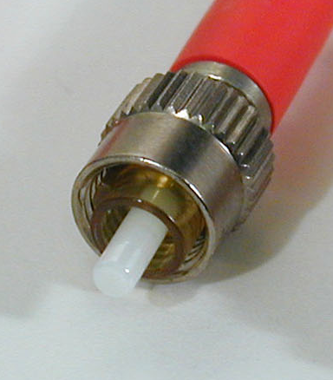
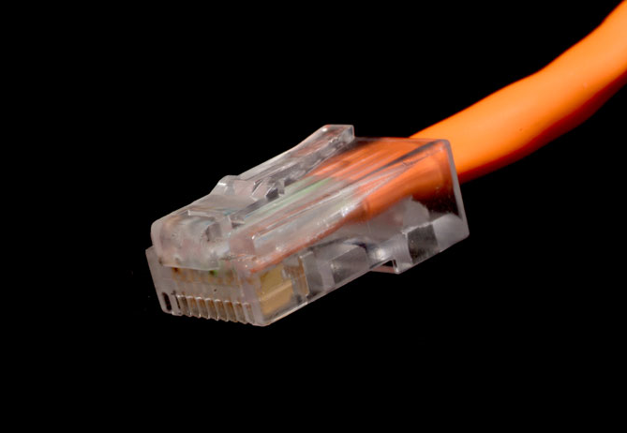
Physical Layer
Responsible for transmitting individual bits from one node to the next
Duties/services
Physical characteristics of interfaces and media
Representation of bits
Data rate (transmission rate)
Synchronization of bits

Slide 108
Physical Layer
from Data Link
to Data Link
Data
Data
Physical Layer
01001011
01001011
(bits)
Transmission medium

Slide 109
The Big Picture
5
5
L5 data
H5
L5 data
H5
4
4
L4 data
H4
L4 data
H4
3
3
L3 data
H3
L3 data
H3
2
2
T2
L2 data
H2
T2
L2 data
H2
1
1
0111011010101001010101001
0111010101010010101010101
Transmission medium

Slide 110
Internet Model
sender
router
router
receiver
Application
Transport
Network
Data Link
Physical
Application
Transport
Network
Data Link
Physical
Network
Network
D.L.
D.L.
D.L.
D.L.
P.L.
P.L.
P.L.
P.L.
Transmission medium

Slide 111
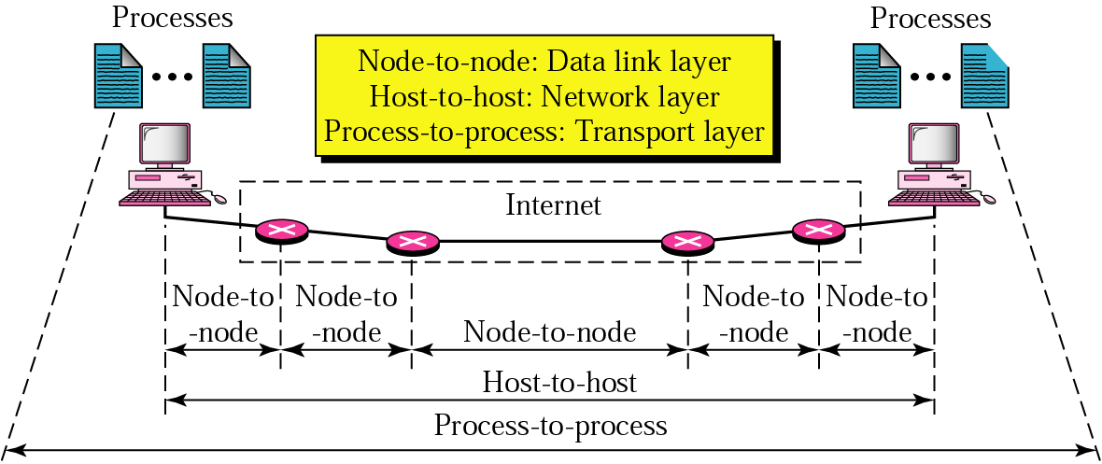
Internet Model

Slide 112
Protocol Suites
A set of protocols must be constructed
to ensure that the resulting communication system is complete and efficient
Each protocol should handle a part of communication not handled by other protocols
How can we guarantee that protocols work well together?
Instead of creating each protocol in isolation, protocols are designed in complete, cooperative sets called suites or families
112
Notes:
112

Slide 113
Internet Protocol Suite
Layer | Protocols
Application | HTTP, FTP, Telnet, SMTP, ...
Transport | TCP, UDP, SCTP, ...
Network | IP (IPv4), IPv6, ICMP, IGMP, ...
Data Link | Ethernet, Wi-Fi, PPP, ...
Physical | RS-232, DSL, 10Base-T, ...

Slide 114
OSI Model
User
OSI – Open Systems Interconnection
Developed by the International Standards Organizations (ISO)
Two additional layers
Presentation layer
Session layer
7.Application Layer
6.Presentation Layer
5.Session Layer
4.Transport Layer
3.Network Layer
2.Data Link Layer
1.Physical Layer
Transmission Medium

Slide 115
Session Layer
Responsible for establishing, managing and terminating connections between applications
Duties/services
Interaction management
⇨ Simplex, half-duplex, full-duplex
Session recovery

Slide 116
Presentation Layer
Responsible for handling differences in data representation to applications
Duties/services
Data translation
Encryption
Decryption
Compression

Slide 117














OSI Layers in Real World
7.Manager
Handwrites a message
Reads the message
Prepares final version
Summarizes or translates letter
6.Assistant
Provides address and packs letter
Opens letter
5.Secretary
Delivers letter to post office
Withdraws letter from mailbox
4.Driver
Checks address and sorts letter
Checks address and sorts letter
3.Postal staff
Packs letters for certain directions
Unpacks packages
2.Postal staff
Loads on truck
Unloads from truck
1.Postal staff
transmission medium
Pictures from Wikipedia

